Slide 1
Build Android SDK using Swagger Codegen
Build NAPI
Note:
Mobile Side SDK Deployment managed using Jenkins
Create temporary Amazon S3 bucket to upload Lambda zips
Build
CloudFormation Template
Deploy
AWS CloudFormation Template as a stack on cloud
Post Deployment Validation and Verification
Delete the Lambda zips from S3 & S3 bucket

Slide 2
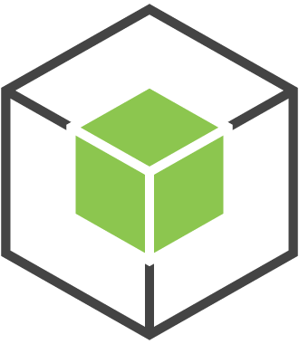



Create stack
AWS SDK-
Node.js +
CloudFormation-deploy package
CloudFormation template
AWS CloudFormation
stack

Slide 3
Update stack
AWS SDK-
Node.js +
CloudFormation-deploy package
Updated
CloudFormation template
AWS CloudFormation
Updated stack

